Slide 1

SEMESTER PROJECT-ESE
SMART CITY: NETWORKED TRAFFIC CONTROL OF AUTONOMOUS VEHICLES
GROUP 5
Akash Cuntur Shrinivasmurthy [7219642]
Akhil Narayanaswamy [7219528]
Krithika Premkumar [7218970]
Madhukar Devendrappa [7219639]

Slide 2
AGENDA
ANALYSIS
DESIGN
IMPLEMENTATION
TESTING

Slide 3
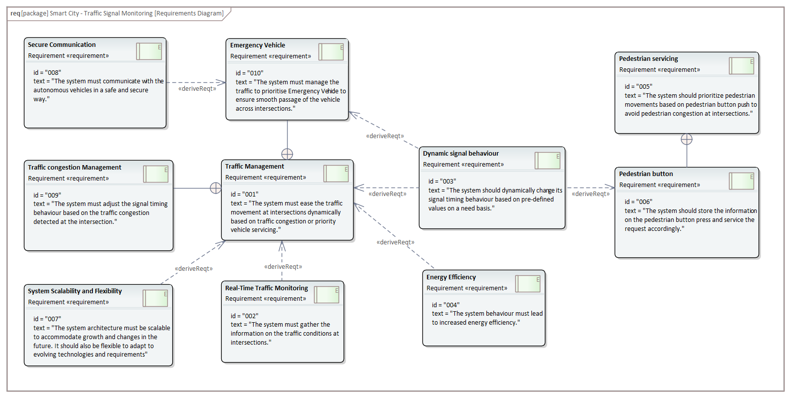
ANALYSIS REQUIREMENTS

Slide 4
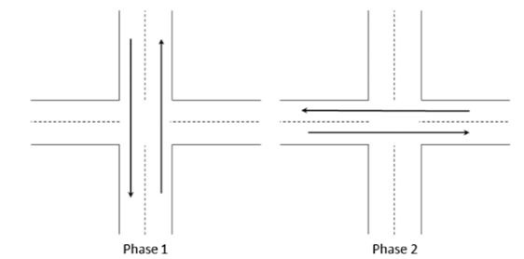
ANALYSIS
USE CASE AND ACTIVITY DIAGRAM
The following use cases have been identified for our system:
A two phase intersection.
Traffic signal timing adjustment based on real time traffic density
Emergency Vehicle priority handling
Pedestrian cross request servicing

Slide 5
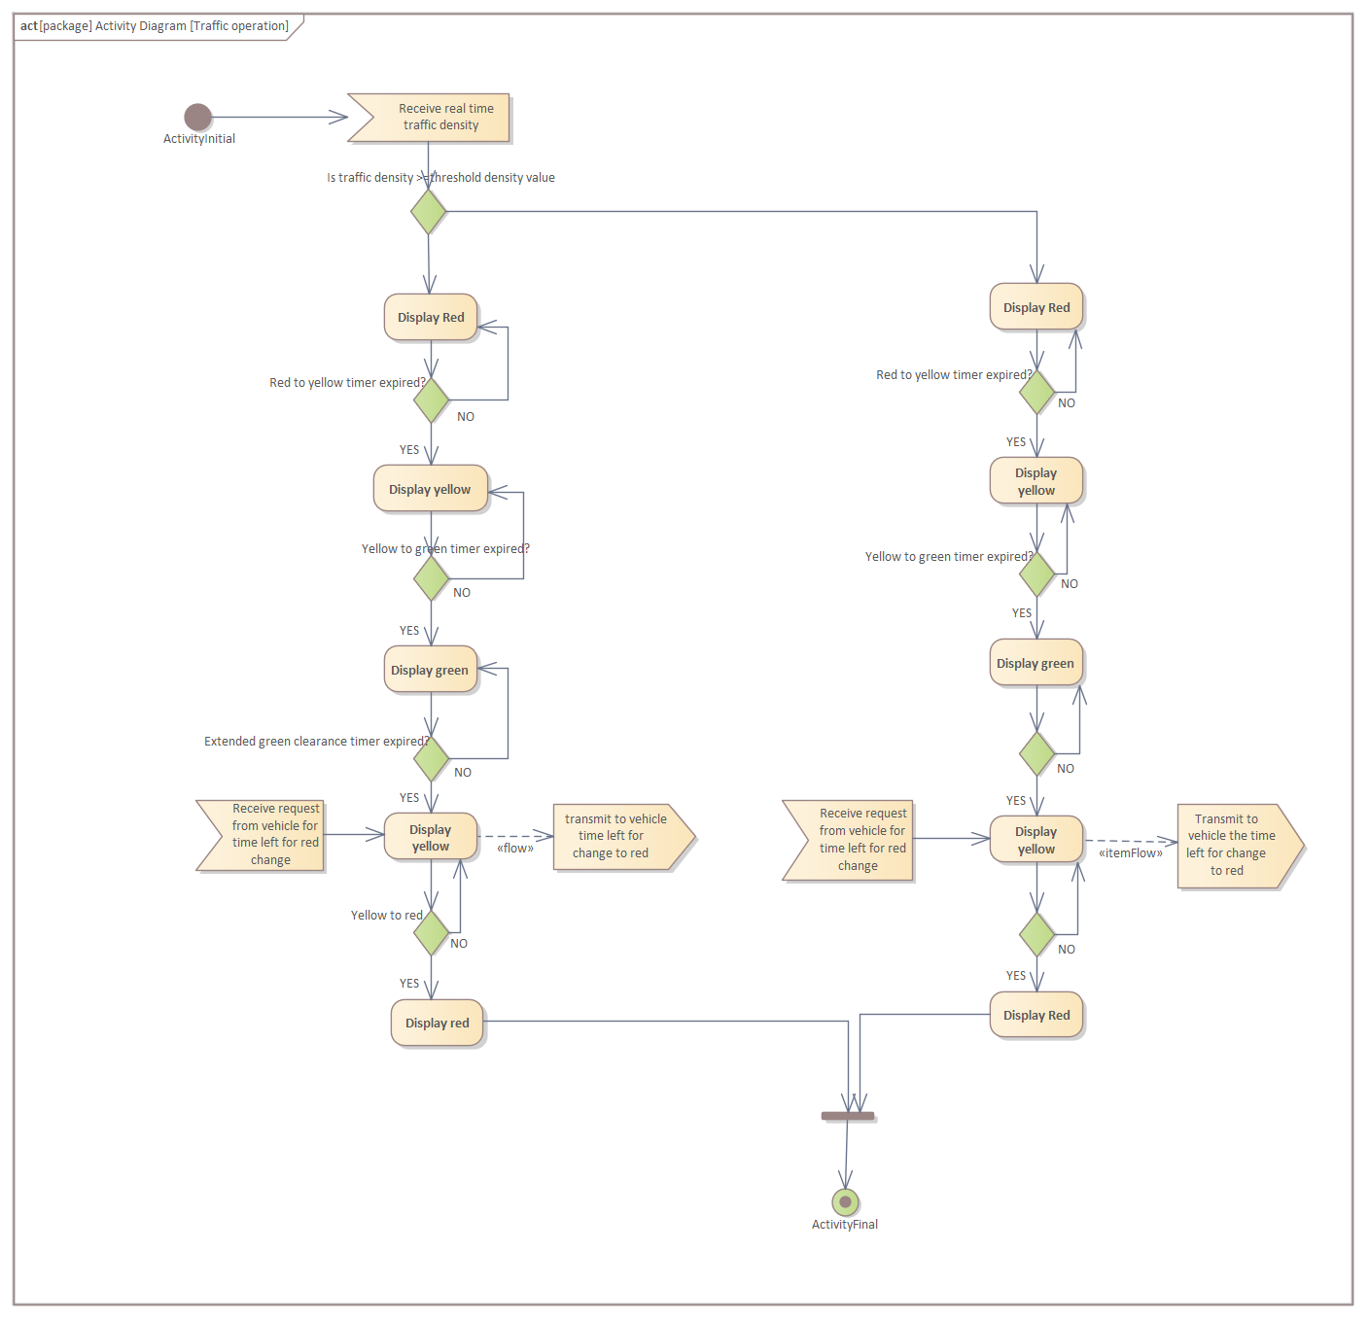

Slide 6
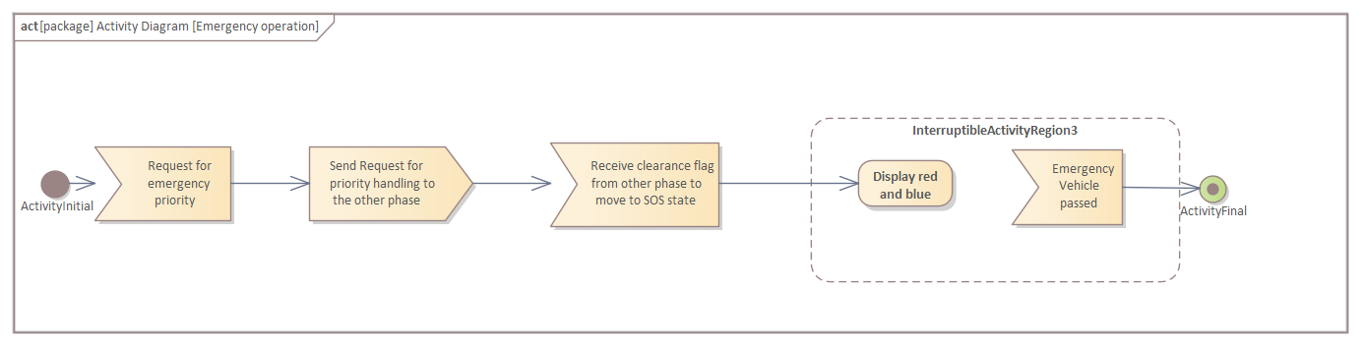

Slide 7
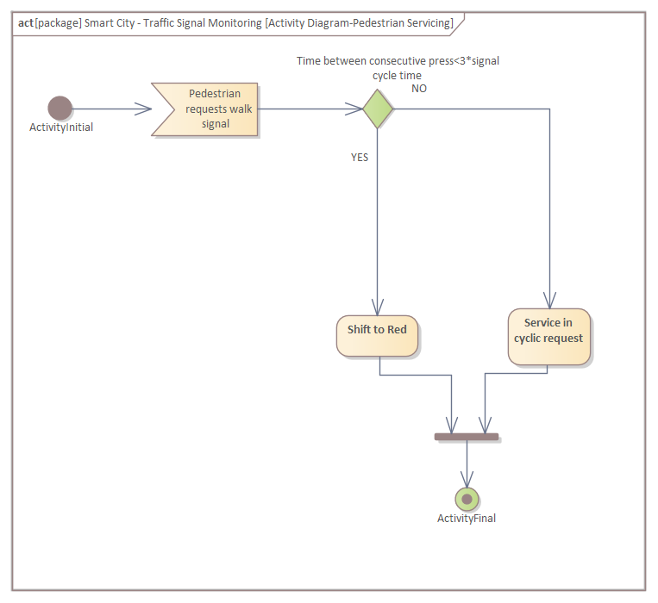

Slide 8
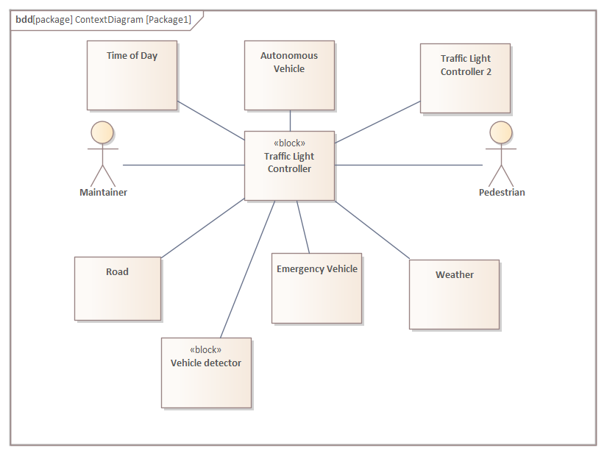
ANALYSIS
CONTEXT DIAGRAM

Slide 9
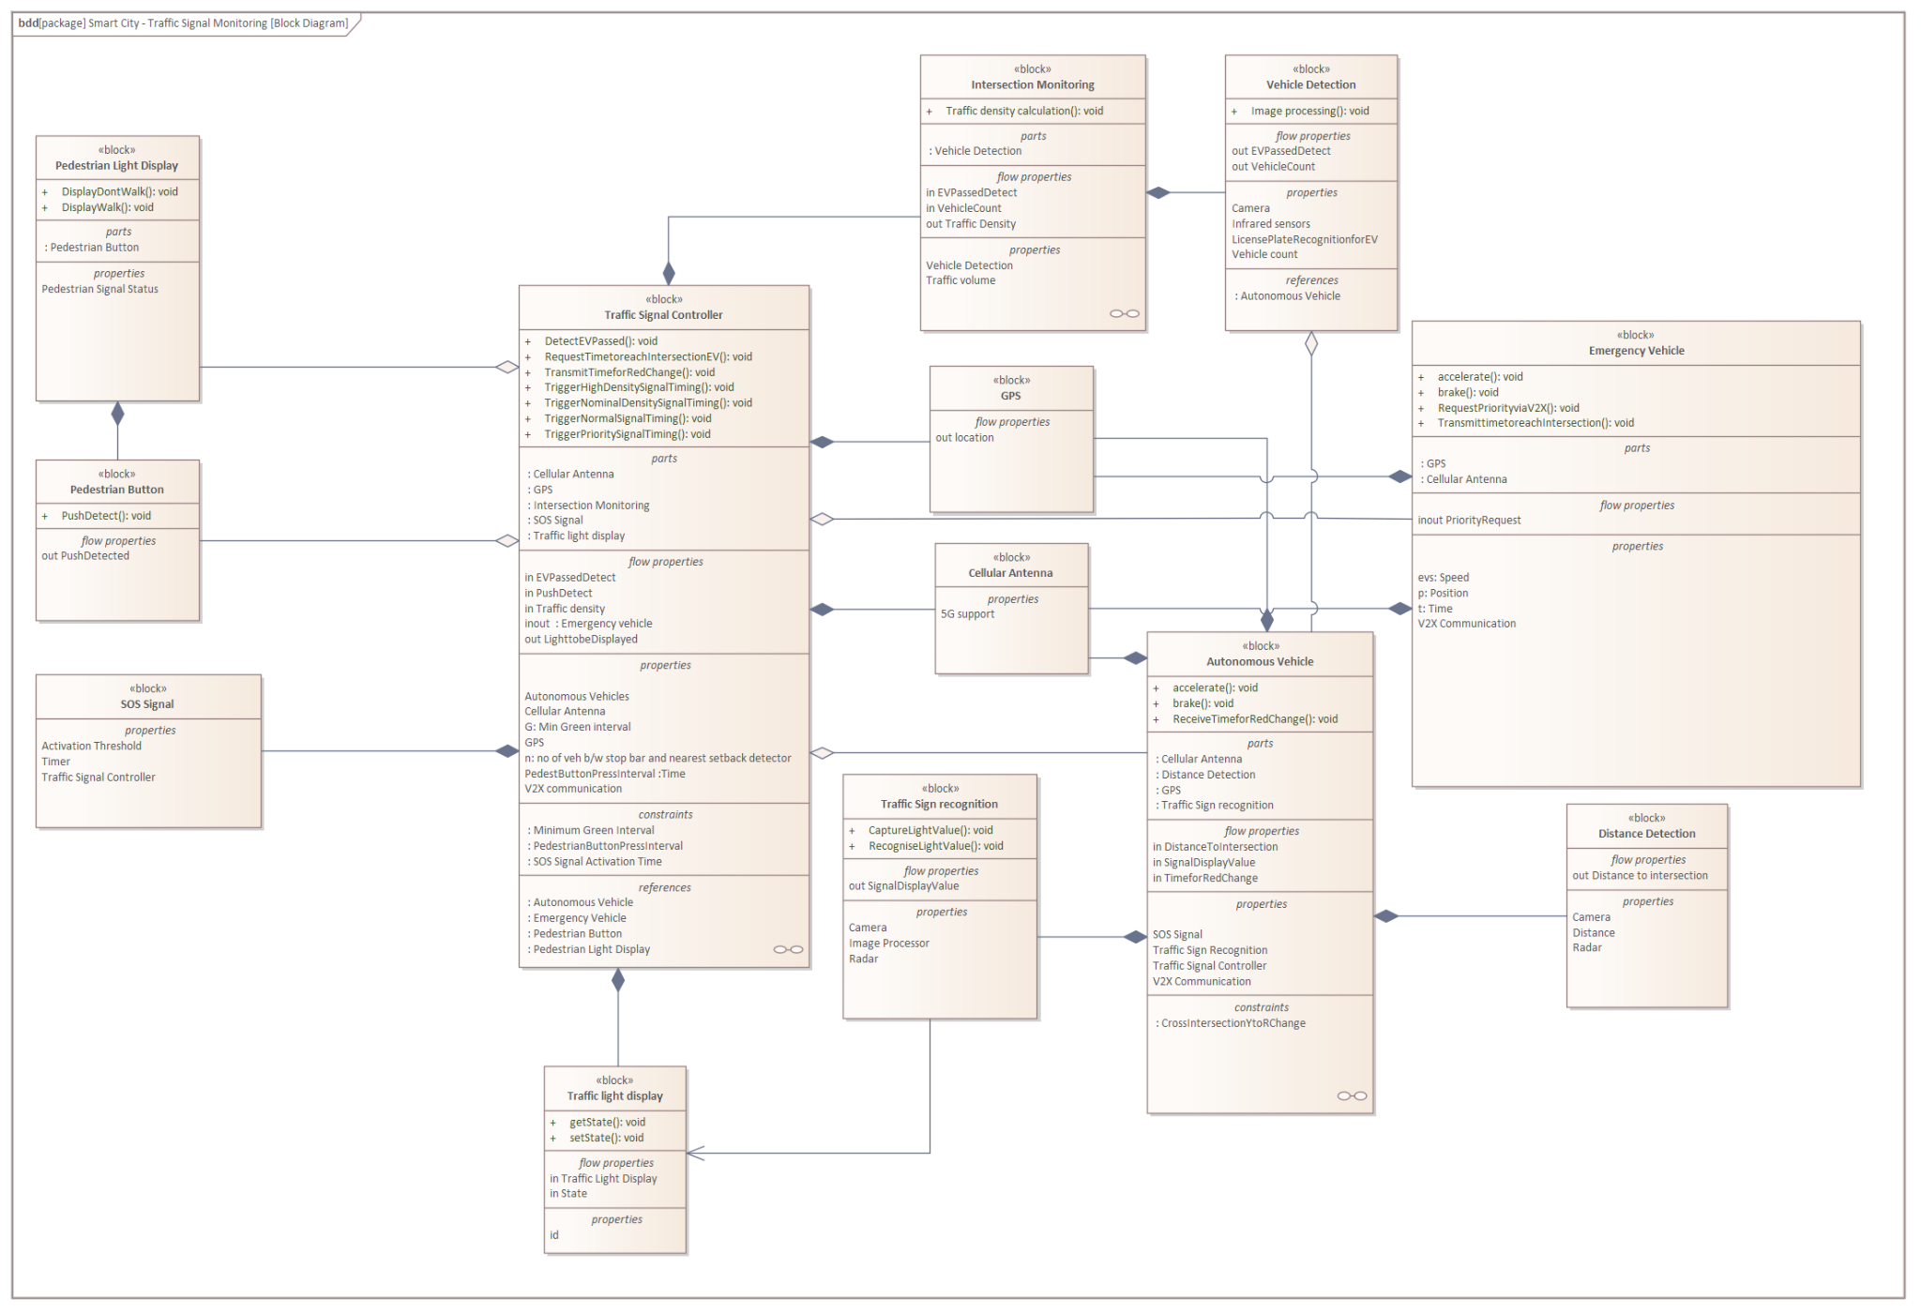
ANALYSIS
BLOCK DIAGRAM

Slide 10
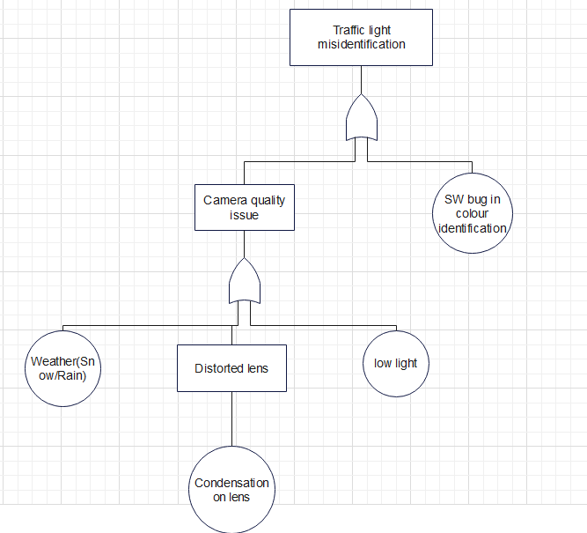
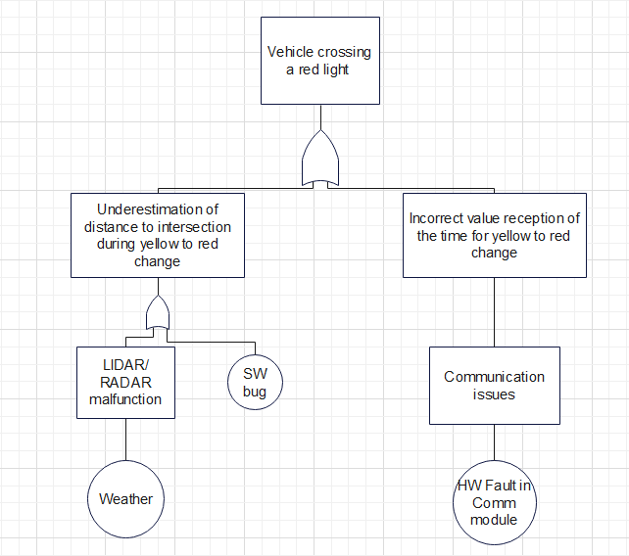
ANALYSIS
FAULT ANALYSIS

Slide 11
ANALYSIS
FAULT ANALYSIS
Traffic Light Misdetection
In case of unclear weather conditions, request for traffic light status from traffic light controller via V2I communication
In case of camera quality issues, the traffic light recognition function is to be shown as unavailable to the driver based on the level of autonomous driving for driver intervention
Crossing a red light
Redundant CAN Channels in case of CAN communication failure to receive critical information
In case of system unavailability such as RADAR/LiDAR, the information must be displayed to the driver based on the level of autonomous driving for driver intervention

Slide 12
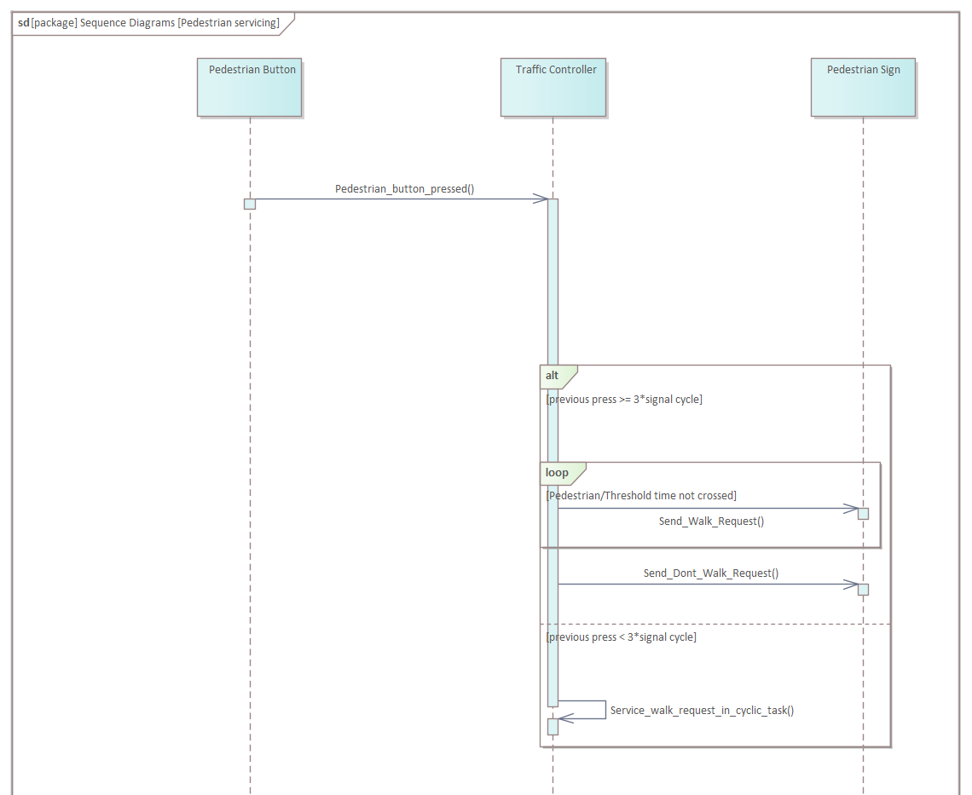
ANALYSIS
SEQUENCE DIAGRAM

Slide 13
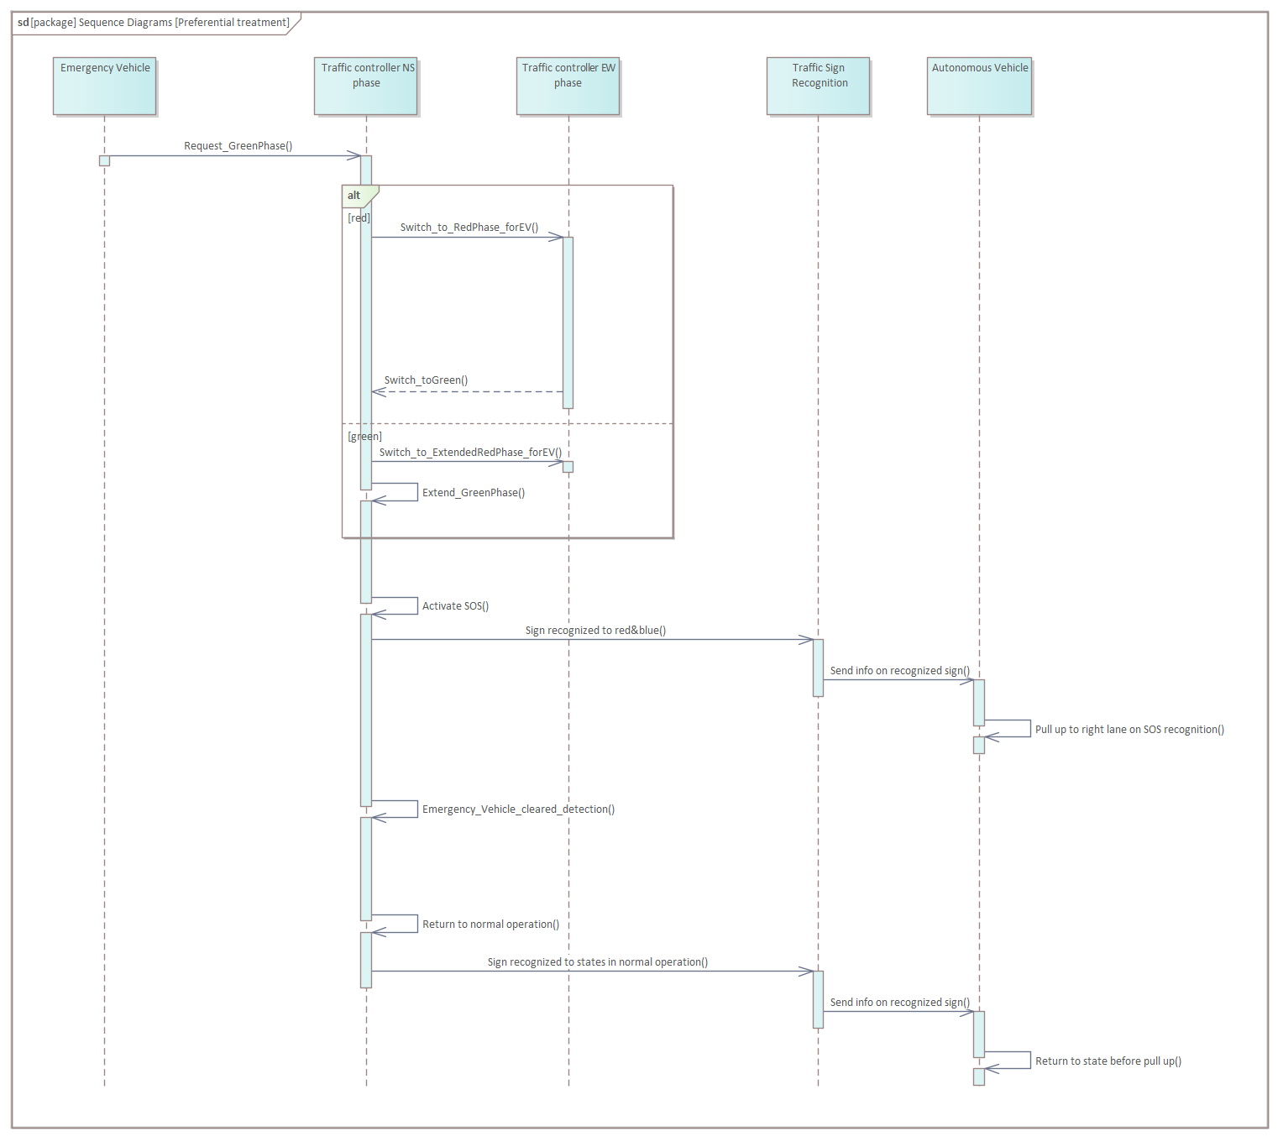
ANALYSIS
SEQUENCE DIAGRAM

Slide 14
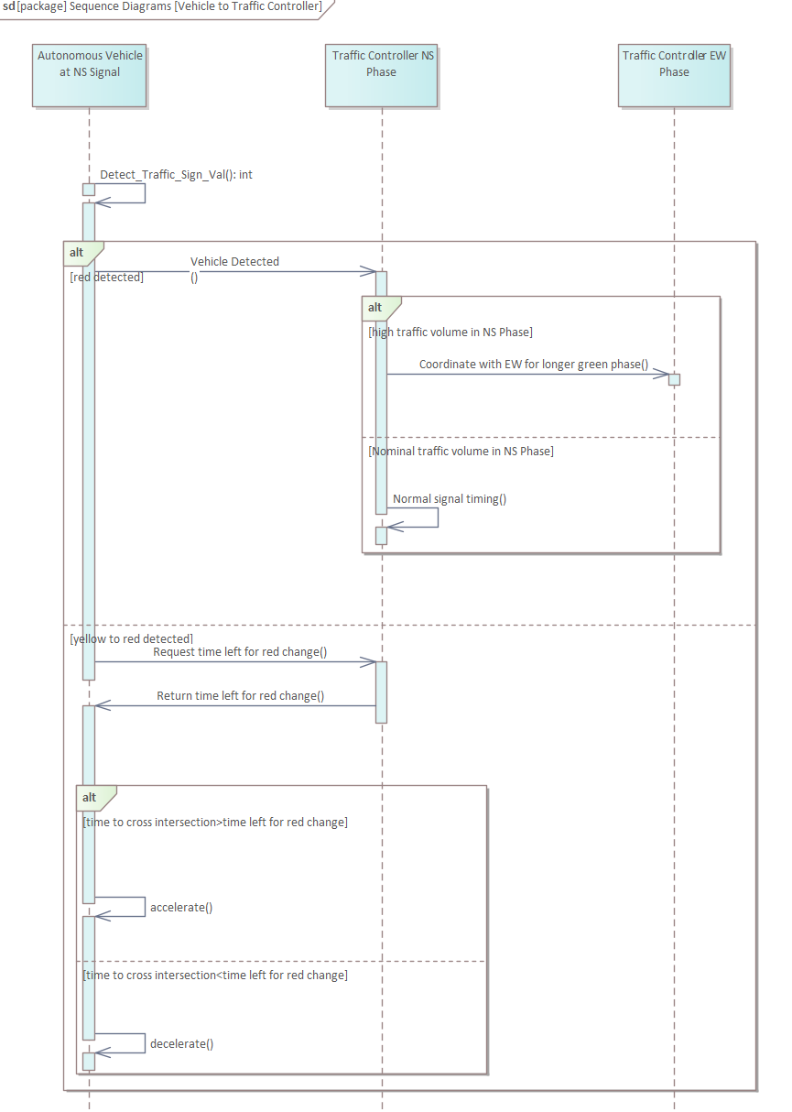
ANALYSIS
SEQUENCE DIAGRAM

Slide 15
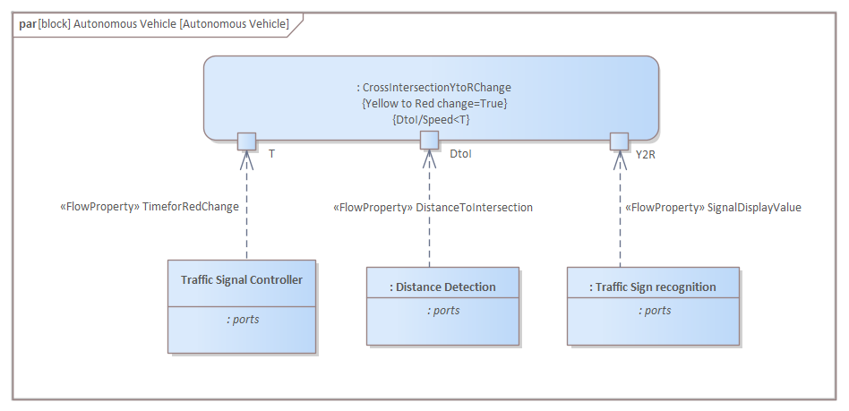
ANALYSIS
PARAMETRIC CONSTRAINT DIAGRAM

Slide 16
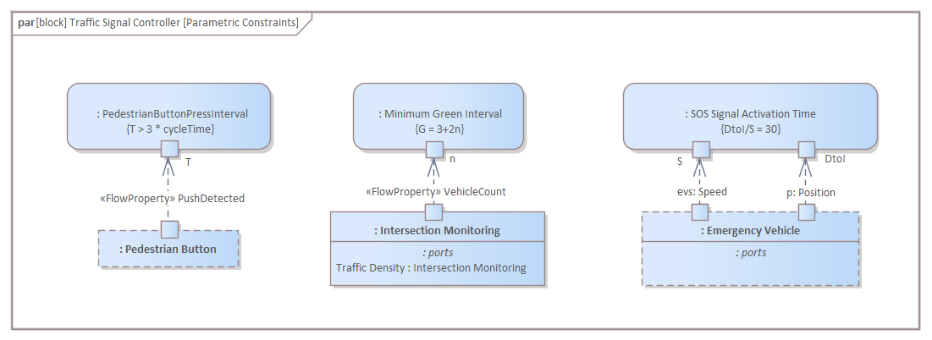
ANALYSIS
PARAMETRIC CONSTRAINT DIAGRAM

Slide 17
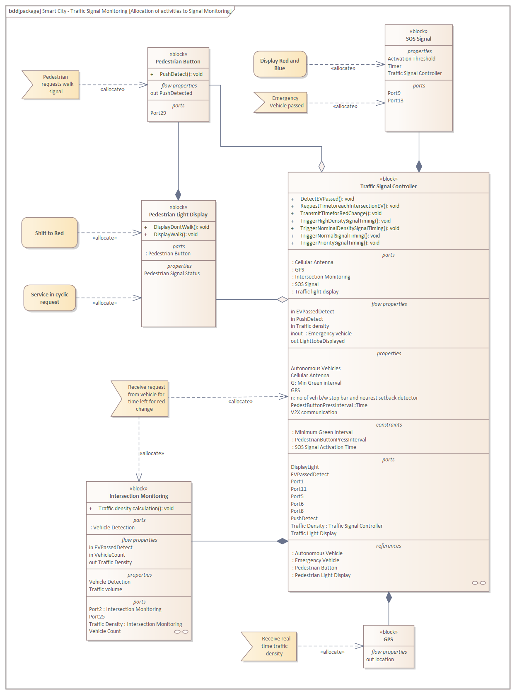
ANALYSIS
ALLOCATION DIAGRAM

Slide 18
AGENDA
ANALYSIS
DESIGN
IMPLEMENTATION
TESTING

Slide 19
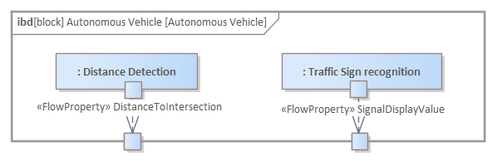
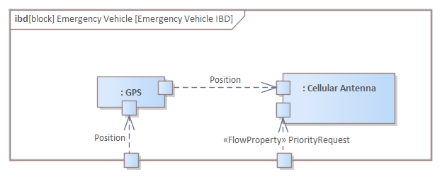
DESIGN
INTERNAL BLOCK DIAGRAM

Slide 20
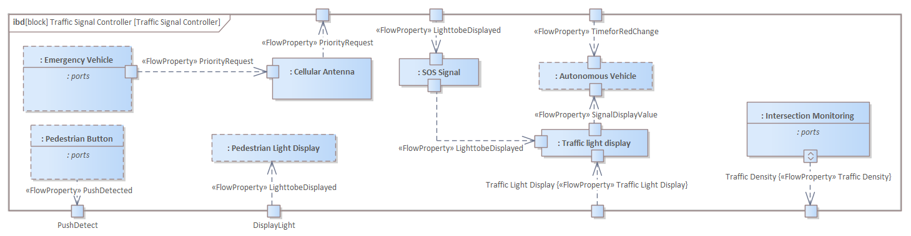
DESIGN
INTERNAL BLOCK DIAGRAM

Slide 21
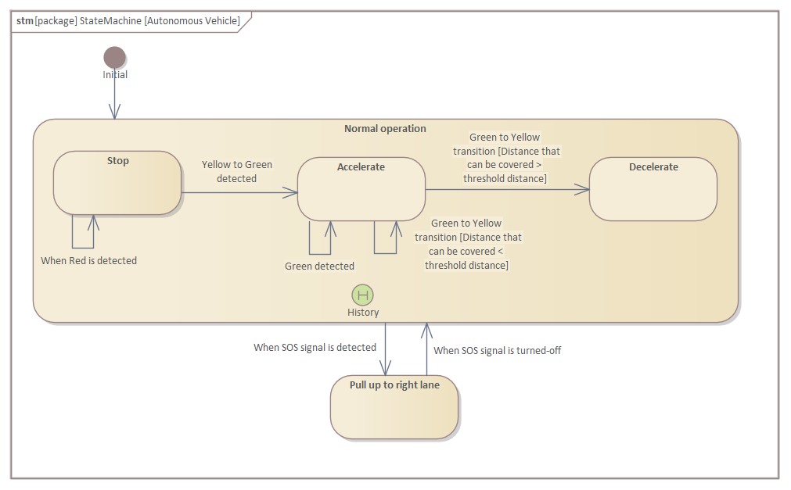
DESIGN
STATE MACHINE DIAGRAM

Slide 22
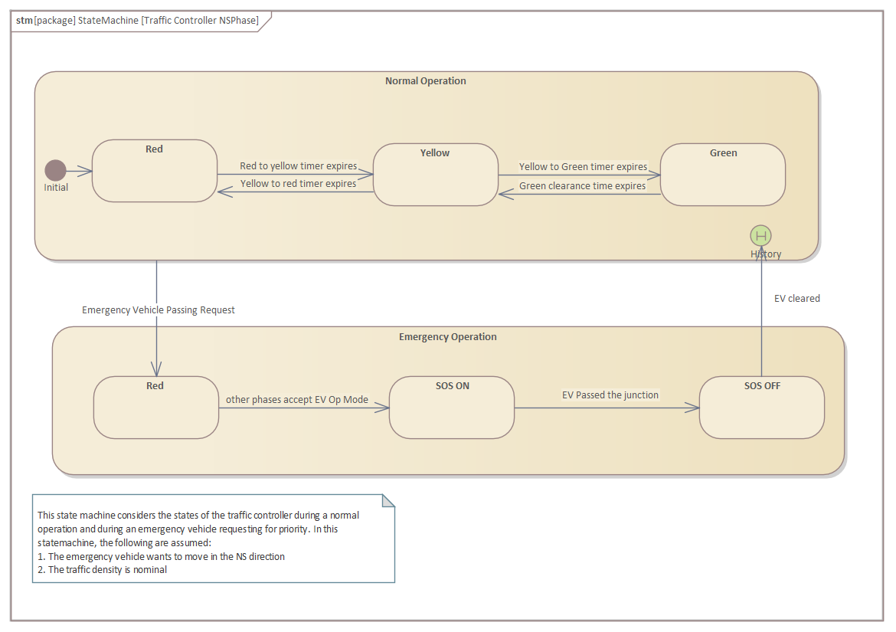
DESIGN
STATE MACHINE DIAGRAM

Slide 23
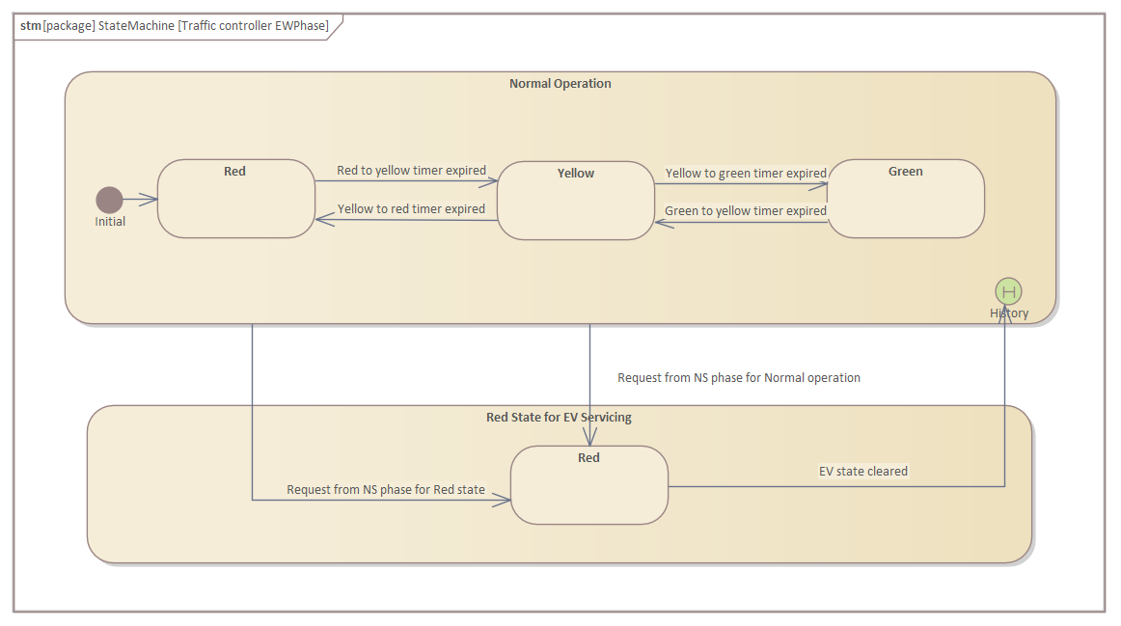
DESIGN
STATE MACHINE DIAGRAM

Slide 24
AGENDA
ANALYSIS
DESIGN
IMPLEMENTATION
TESTING

Slide 25
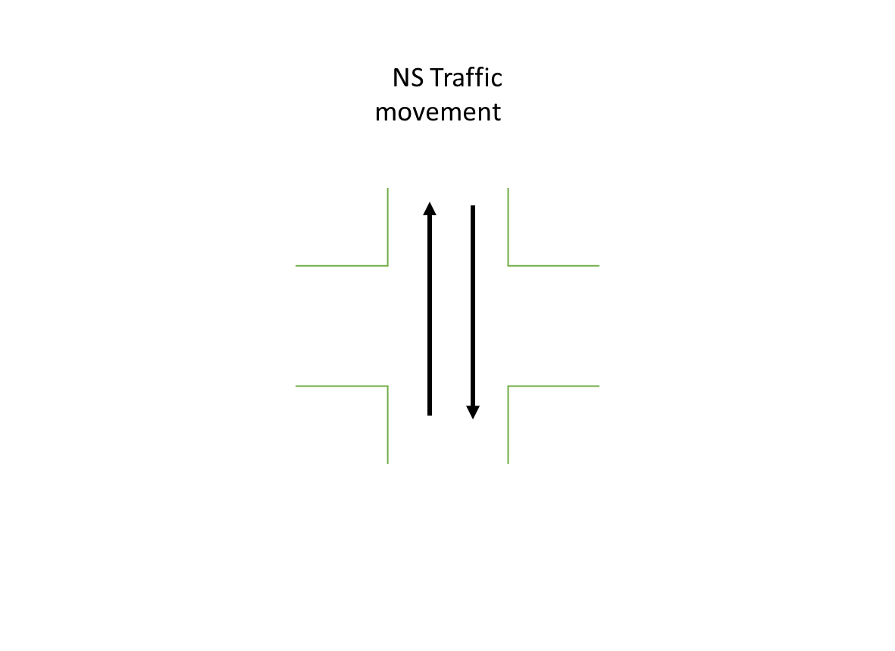
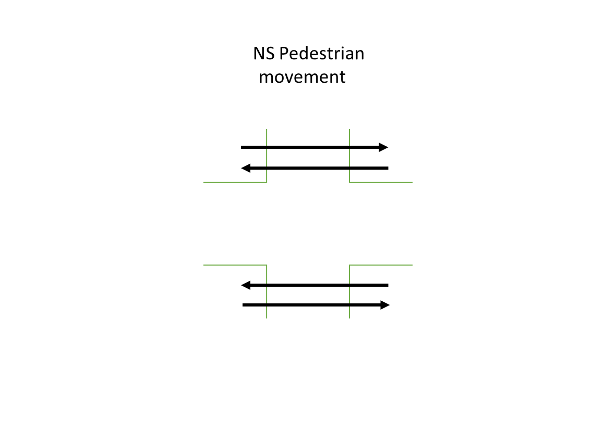
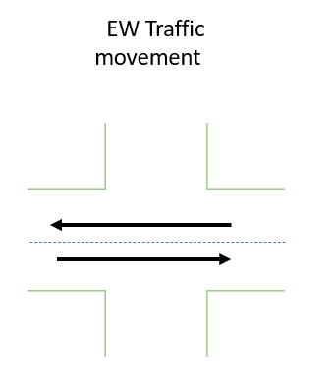
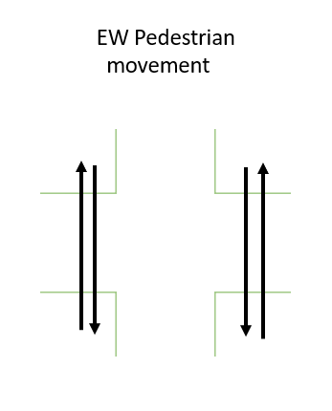
IMPLEMENTATION
TERMINOLOGY

Slide 26
IMPLEMENTATION
NORMAL OPERATION DURATION CYCLE
State | Duration
Green | 26 sec
Yellow | 3 sec
Red | 31 sec

Slide 27
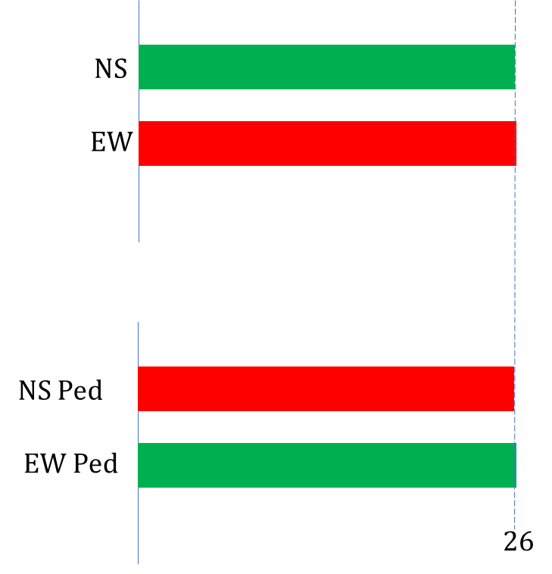
IMPLEMENTATION
NORMAL OPERATION

Slide 28
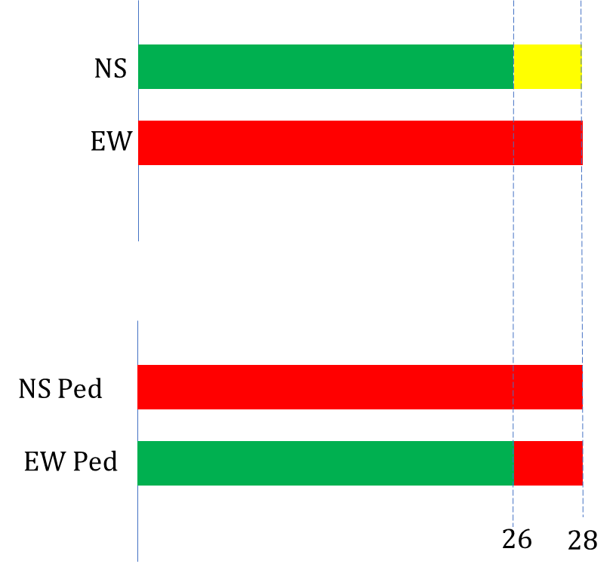
IMPLEMENTATION
NORMAL OPERATION

Slide 29
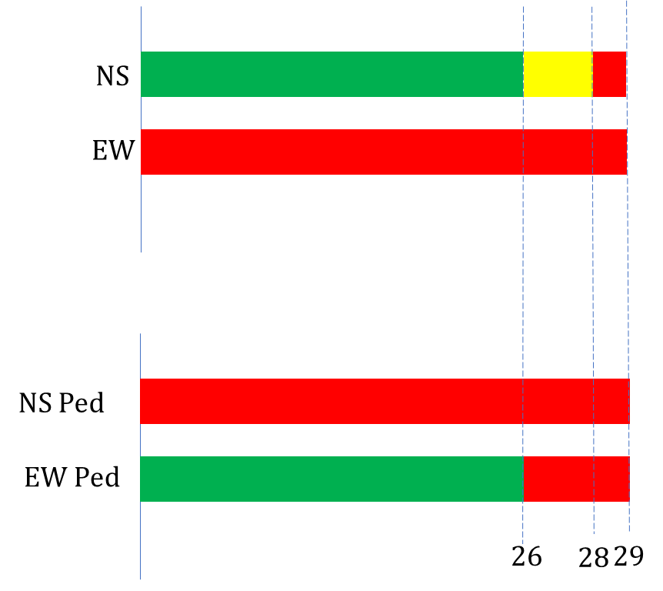
IMPLEMENTATION
NORMAL OPERATION

Slide 30
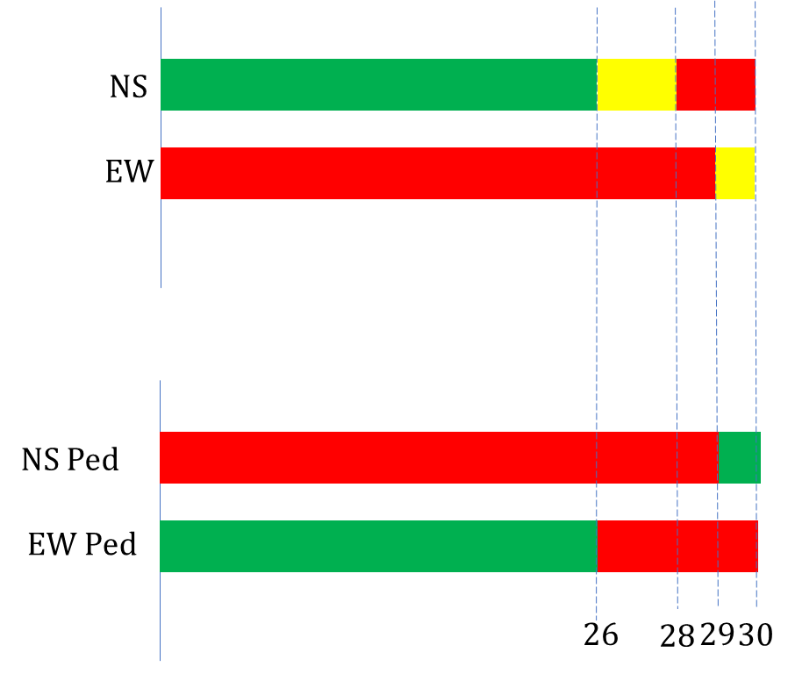
IMPLEMENTATION
NORMAL OPERATION

Slide 31
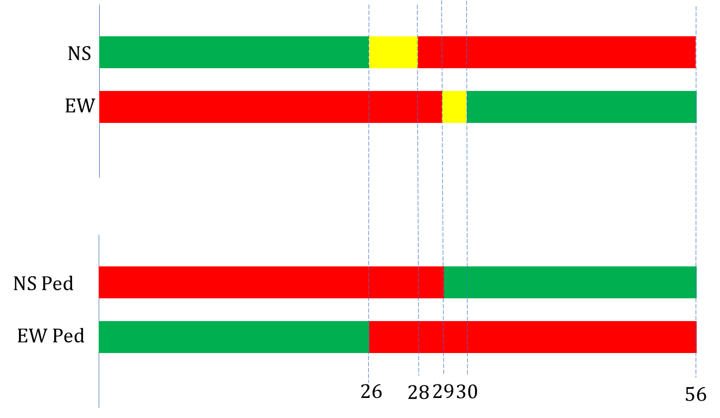
IMPLEMENTATION
NORMAL OPERATION

Slide 32
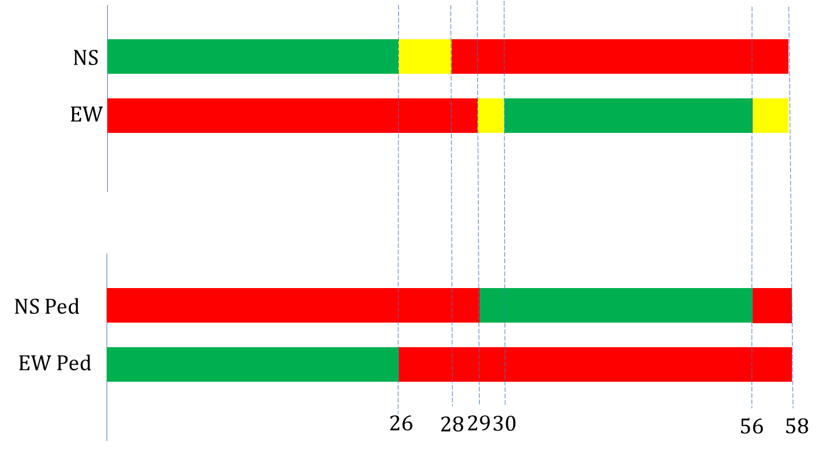
IMPLEMENTATION
NORMAL OPERATION

Slide 33
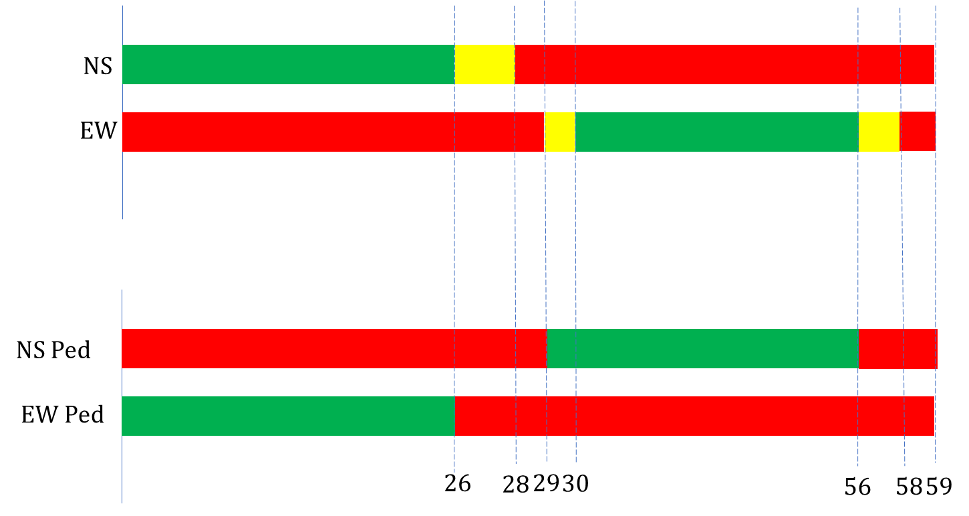
IMPLEMENTATION
NORMAL OPERATION

Slide 34
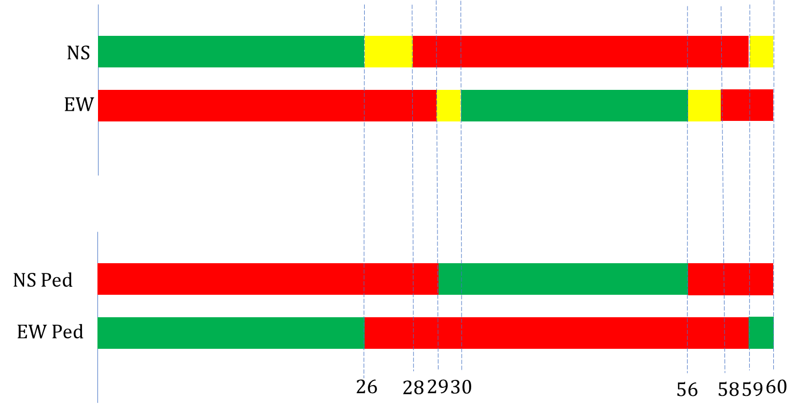
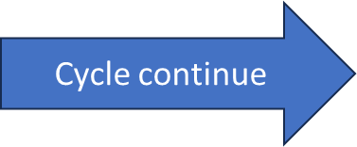
IMPLEMENTATION
NORMAL OPERATION

Slide 35
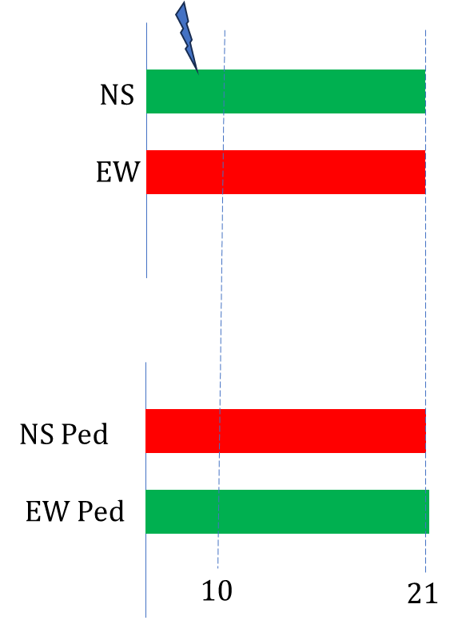
IMPLEMENTATION
NS PEDESTRIAN INTERRUPT OPERATION

Slide 36
IMPLEMENTATION
NS PEDESTRIAN INTERRUPT OPERATION

Slide 37
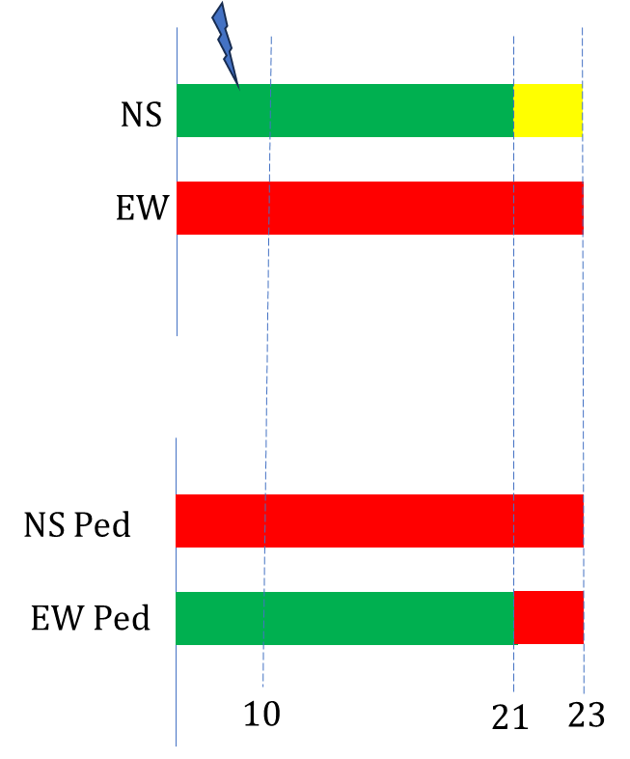
IMPLEMENTATION
NS PEDESTRIAN INTERRUPT OPERATION

Slide 38
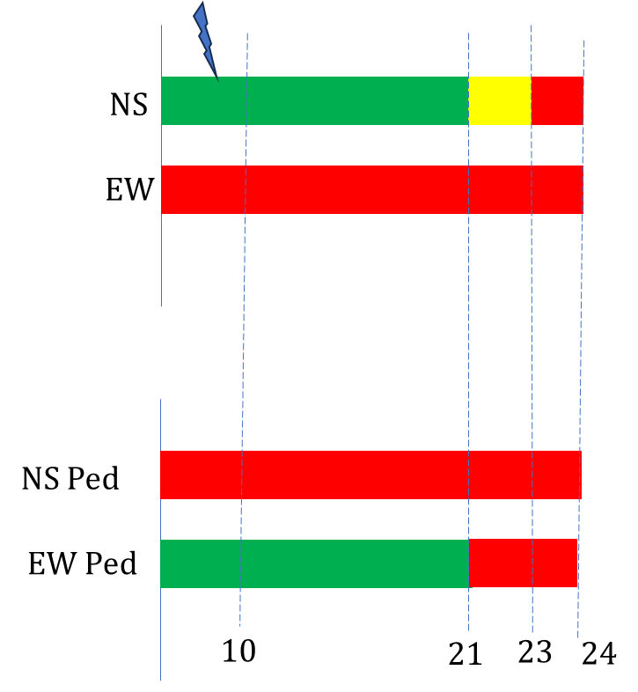
IMPLEMENTATION
NS PEDESTRIAN INTERRUPT OPERATION

Slide 39
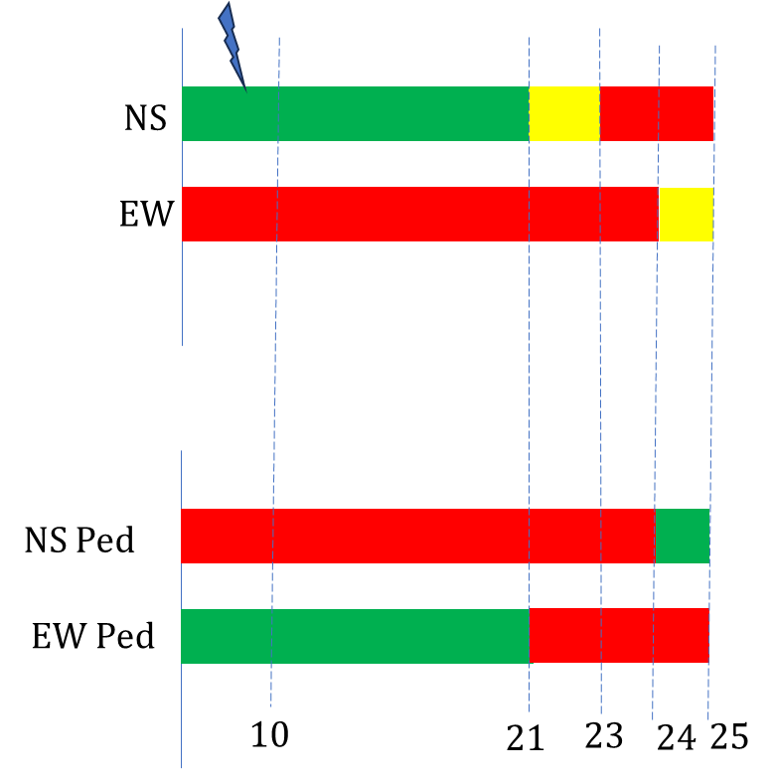
IMPLEMENTATION
NS PEDESTRIAN INTERRUPT OPERATION

Slide 40
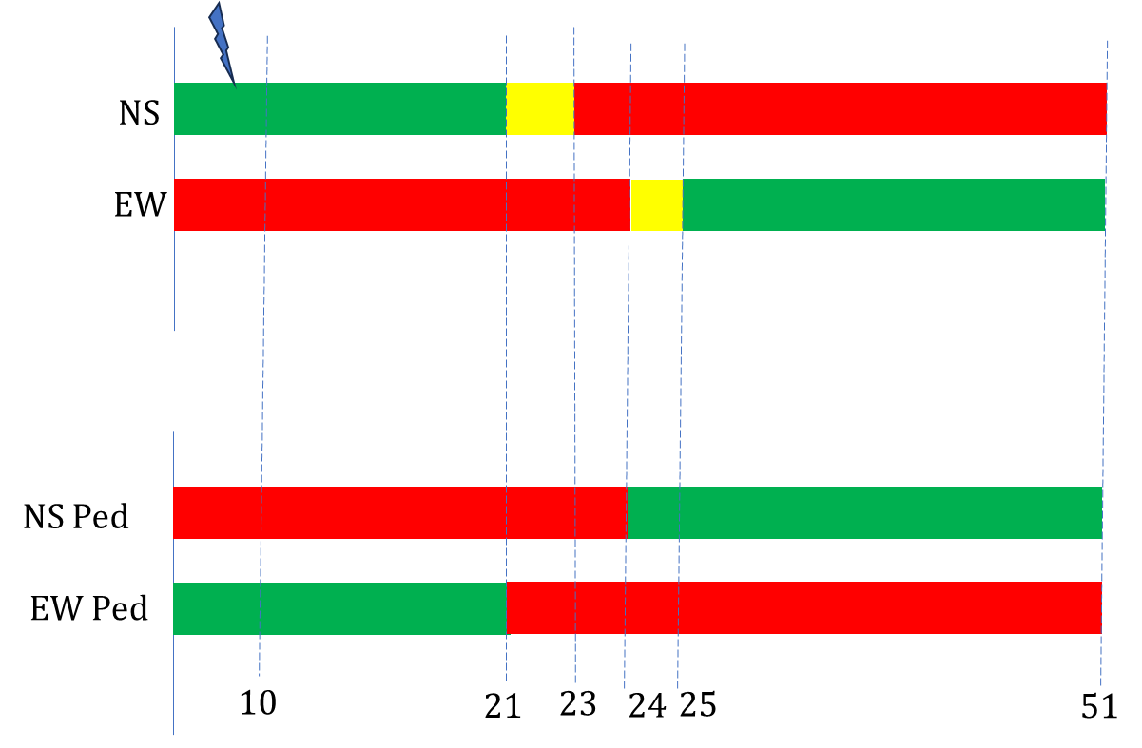
IMPLEMENTATION
NS PEDESTRIAN INTERRUPT OPERATION

Slide 41
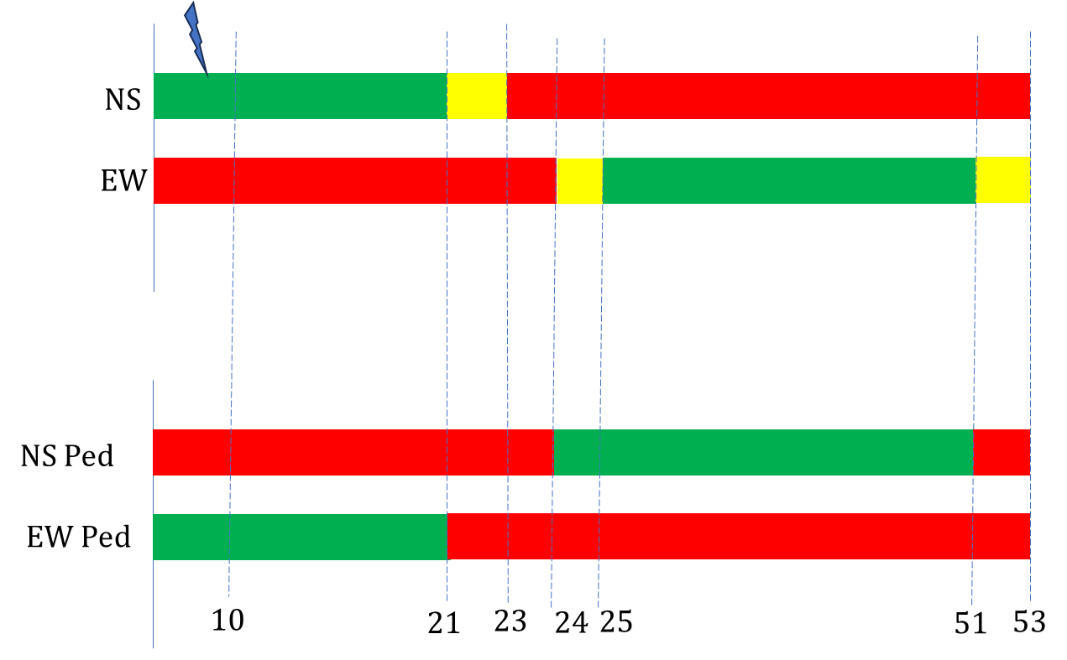
IMPLEMENTATION
NS PEDESTRIAN INTERRUPT OPERATION

Slide 42
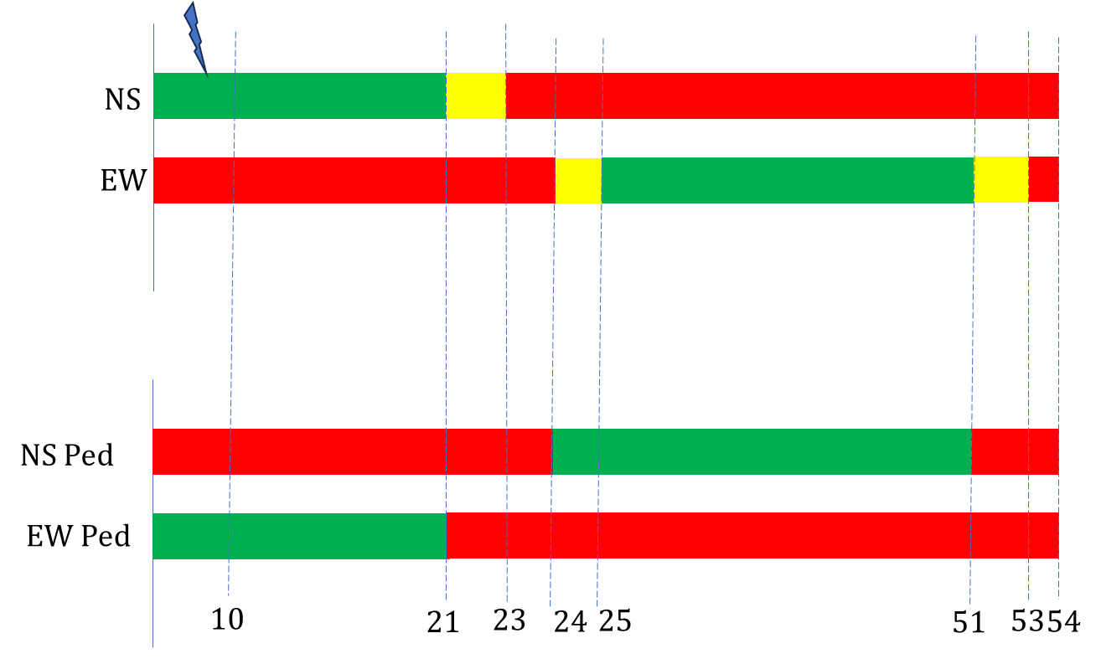
IMPLEMENTATION
NS PEDESTRIAN INTERRUPT OPERATION

Slide 43
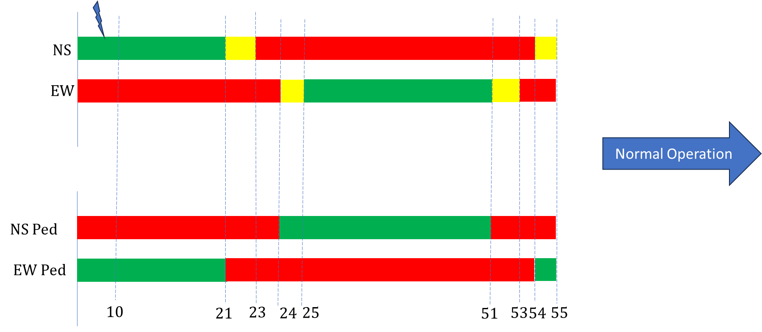
IMPLEMENTATION
NS PEDESTRIAN INTERRUPT OPERATION

Slide 44
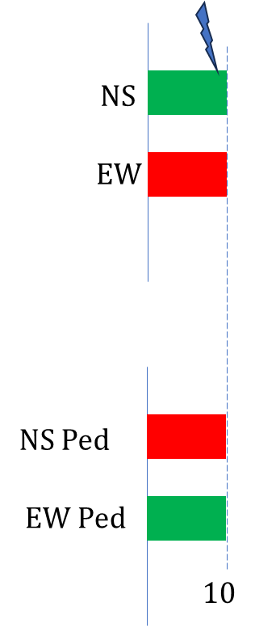
IMPLEMENTATION
NS & EW PEDESTRIAN INTERRUPT OPERATION

Slide 45
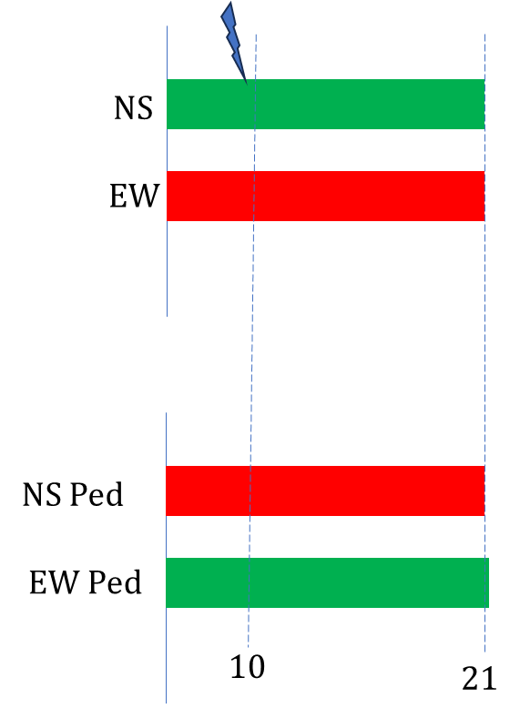
IMPLEMENTATION
NS & EW PEDESTRIAN INTERRUPT OPERATION

Slide 46
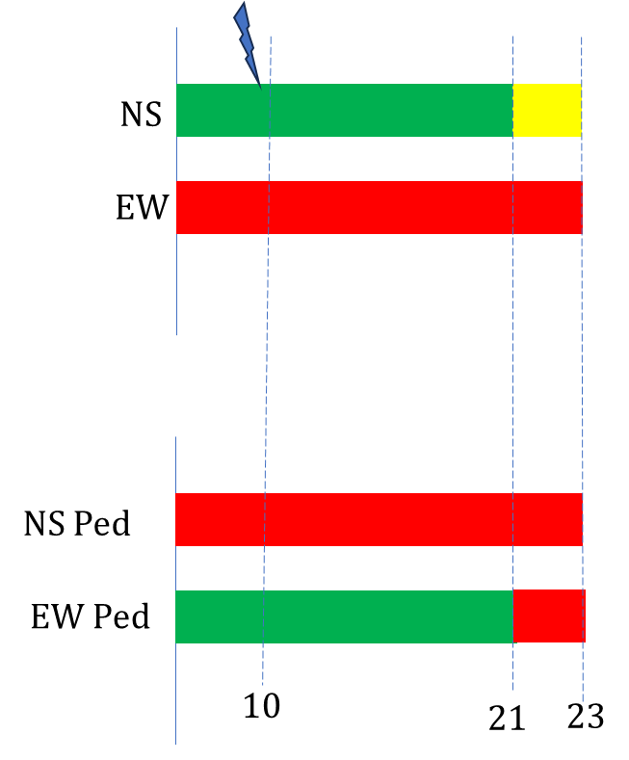
IMPLEMENTATION
NS & EW PEDESTRIAN INTERRUPT OPERATION

Slide 47
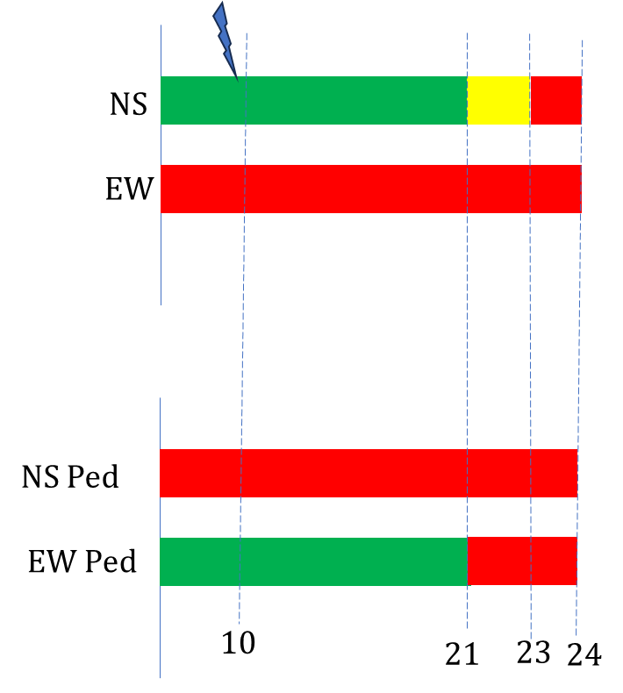
IMPLEMENTATION
NS & EW PEDESTRIAN INTERRUPT OPERATION

Slide 48
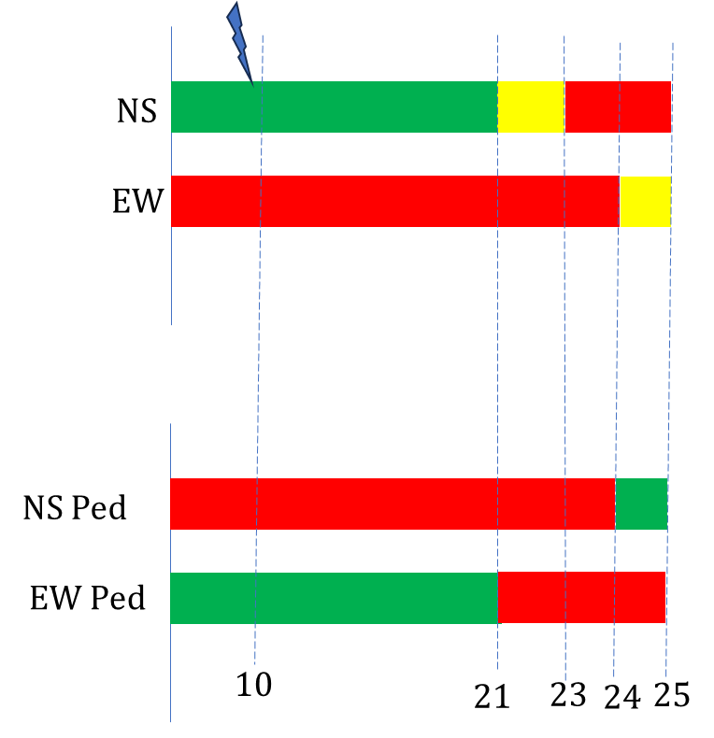
IMPLEMENTATION
NS & EW PEDESTRIAN INTERRUPT OPERATION

Slide 49
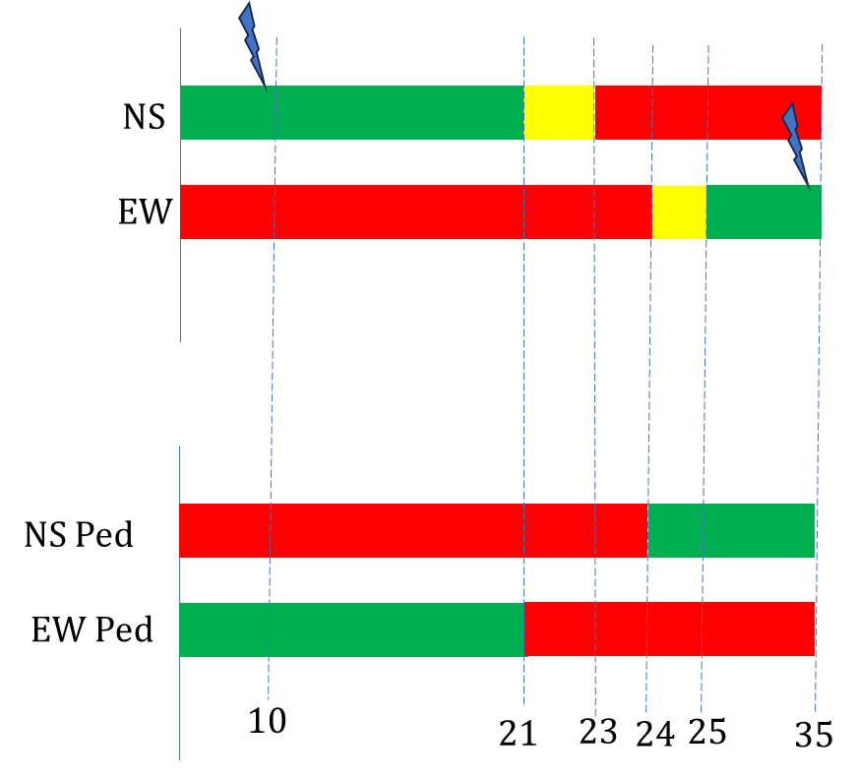
IMPLEMENTATION
NS & EW PEDESTRIAN INTERRUPT OPERATION

Slide 50
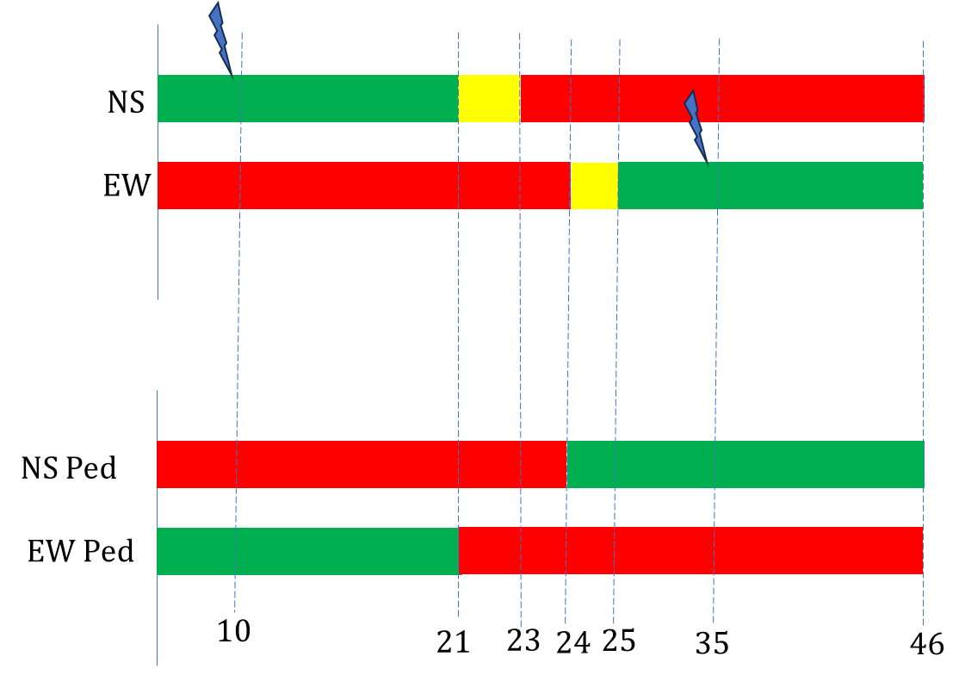
IMPLEMENTATION
NS & EW PEDESTRIAN INTERRUPT OPERATION

Slide 51
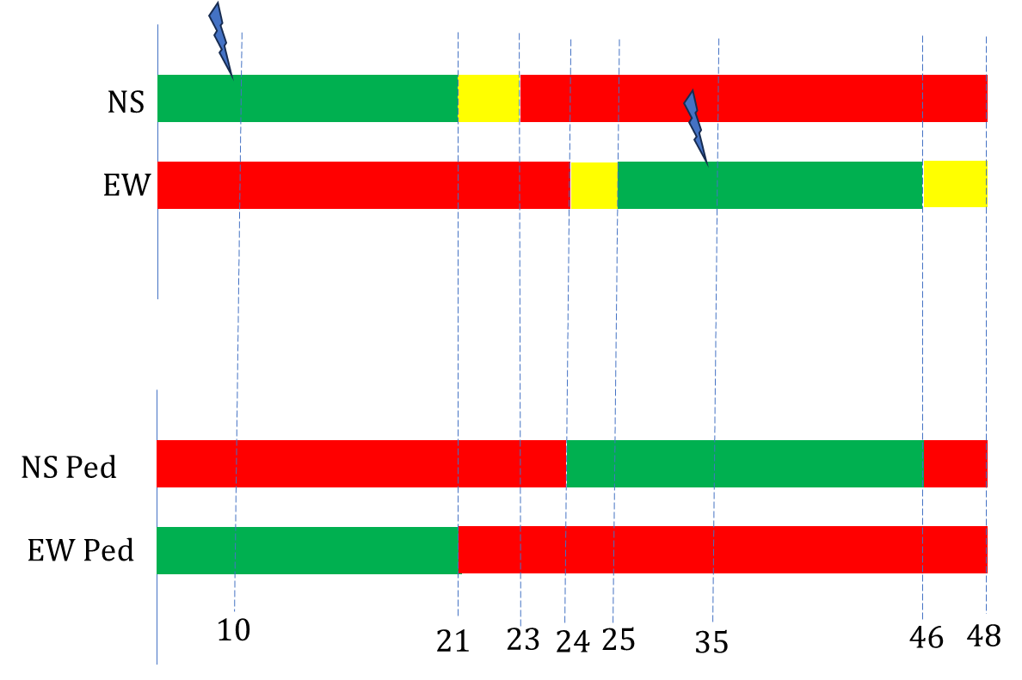
IMPLEMENTATION
NS & EW PEDESTRIAN INTERRUPT OPERATION

Slide 52

IMPLEMENTATION
NS & EW PEDESTRIAN INTERRUPT OPERATION

Slide 53

IMPLEMENTATION
NS & EW PEDESTRIAN INTERRUPT OPERATION

Slide 54

IMPLEMENTATION
SOS INTERRUPT OPERATION

Slide 55

IMPLEMENTATION
NORMAL OPERATION

Slide 56

IMPLEMENTATION
PEDESTRIAN OPERATION

Slide 57

IMPLEMENTATION
SOS OPERATION

Slide 58
IMPLEMENTATION
SCHEDULING
BLOCK CONSIDERED FOR IMPLEMENTATION
Traffic Signal
id state
getState(): State setState(): void

Slide 59
IMPLEMENTATION
SCHEDULING
TASKS
Traffic Signal Display: Display traffic signal information on the LED lights.
Period: 1000ms
Pedestrian Listener: Detect when the pedestrian button is pressed.
Period: 100ms
Emergency Light Listener: Listen for an emergency signal.
Period: 100ms

Slide 60
IMPLEMENTATION
SCHEDULING
Calculating WCET:
WCET = Number of Cycles / Clock Frequency
HARDWARE:
Arduino UNO R3
CPU: ATmega328
Clock Feq: 16MHz
OS: freeRTOS
ASSUMPTION:
freeRTOS tasks = 320000 instructions
Each Line = 1000 instructions

Slide 61
IMPLEMENTATION
SCHEDULING
Calculating WCET:
Task 1: Max number of lines 23 => No of instructions 23000
Task 2: Max number of lines 7 => No of instructions 7000
Task 3: Max number of lines 6 => No of instructions 6000
WCET estimations:
Task 1: 21.4ms
Task 2: 20.4ms
Task 3: 20.3ms

Slide 62
IMPLEMENTATION
SCHEDULING
CONSTRAINTS:
Tasks | Period (ms) | WCET (ms) | Deadline (ms)
Task1 | 1000 | 21.4 | 1000
Task2 | 100 | 20.4 | 100
Task3 | 100 | 20.3 | 100

Slide 63


IMPLEMENTATION
SCHEDULING
SimSo: Rate Monotonic Scheduling
Implementation is Schedulable with RM, CPU utilization

Slide 64


IMPLEMENTATION
SCHEDULING
SimSo: Earliest Deadline First Scheduling
Implementation is Schedulable with EDF, CPU utilization

Slide 65

IMPLEMENTATION
SCHEDULING
Wokwi Online Simulator

Slide 66
AGENDA
ANALYSIS
DESIGN
IMPLEMENTATION
TESTING

Slide 67


TESTING
UNIT TESTING
Test Results:

Slide 68
TESTING
UNIT TESTING
VALIDATION TEST CASES:
Test Suite: TrafficSignal
Test Case: State Check
Test Suite: Scheduler
Test Case: Time 10
Test Case: Time 30
Test Case: Time 28
Test Suite: Emergency
Test Case: Emergency at NS
Test Case: Emergency at EW

Slide 69
TESTING
UNIT TESTING
DEFECT TEST CASES:
Test Suite: DefectiveTests
Test Case: Invalid Traffic Signal ID
Test Case: Invalid Scheduler Initialization
Test Case: Invalid Time for Scheduler
Test Case: Invalid TrafficSignalState for Set State
Test Case: Invalid TrafficSignalState Transition
TEST DRIVEN DEVELOPMENT:
Test Suite: DefectiveTests Fixer
Test Case: Fix Invalid Traffic Signal ID

Slide 70
THANK YOU

